Slide 1

DM8100 – high Performance computing | EXAM PROJECT
MATHIAS PIERRON, ANTIGONI KARAGIANNAKI, AMANCIO FFELIPE ZANI DA SILVA
SDU, spring 2026

Slide 2
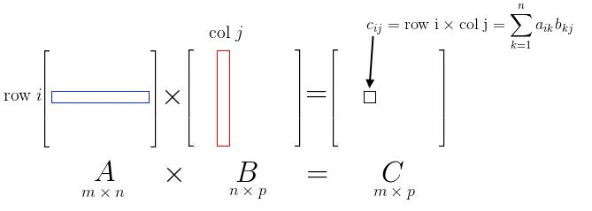


Problem overview
Matrix-Matrix Multiplication C = A x B
Computational complexity: 𝑂(𝑁³)
Goal: Compare scaling across different parallel paradigms
Implementations tested:
Serial (baseline)
OpenMP (shared memory)
MPI (distributed memory)
CUDA (GPU acceleration)

Slide 3
Experimental setup
Hardware Specifications:
Matrix Sizes Used: [1024, 2048, 4096, 6144]
Timing Methods: omp_get_wtime()
Validation Methods:
Checksum
Norm difference
UCLOUD
vCPU 48,96 (AMD EPYC 9655)
Memory 288, 576 GB (DDR5-6400)
1,2 NVIDIA B200
LOCALLY
Intel(R) Core(TM) i7-10750H CPU
RAM 16 GB
NVIDIA GeForce GTX 1650 (4 GB), Intel(R) UHD Graphics (128 MB)

Slide 4
PARADIGMS
Serial
OpenMP
MPI
CUDA
TASK 0
TASK 1
TASK 2
TASK 3
Notes:
GOAL: implement a matrix-matrix multiplication using different parallelization paradigms. We look at shared-memory systems with OpenMP. Distributed
memory system with MPI. And accelerator (GPU) systems with CUDA

Slide 5
Team split
Code Structure Task[0,1,2]
1
Code Optimization Task[0,1,2]
2
GPU runs & Analysis Task[3,4]
3

Slide 6

SCALING
STRONG SCALING
WEAK SCALING

Slide 7

Strong scaling
Definition: Fixed problem size, increase processors
Ideal: Runtime ∝ 1 / P
Metrics:
Speedup
Efficiency

Slide 8
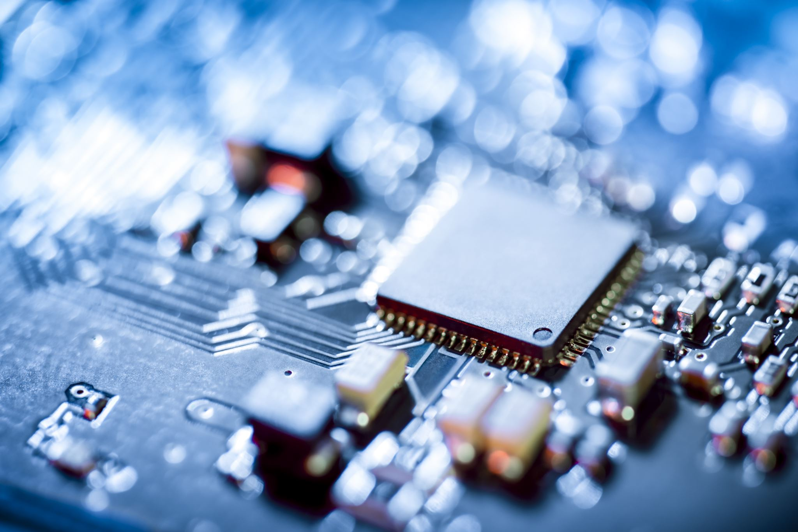
STRONG SCALING - SERIAL
Baseline Reference
No scaling (speedup =1)
Binary: serialMux
Size 1024: baseline T1 = 9.647000 s p=2: T=9.418500 s, speedup=1.024, eff=51.2% p=4: T=9.287000 s, speedup=1.039, eff=26.0% p=8: T=9.731000 s, speedup=0.991, eff=12.4%
Size 2056: baseline T1 = 86.632000 s p=2: T=83.882500 s, speedup=1.033, eff=51.6% p=4: T=85.107000 s, speedup=1.018, eff=25.4% p=8: T=86.754500 s, speedup=0.999, eff=12.5%

Slide 9
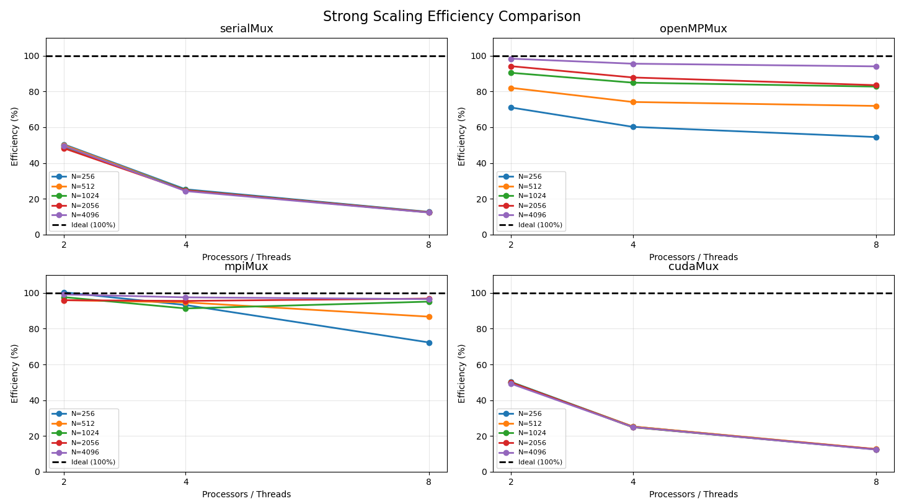
Efficiency comparison

Slide 10
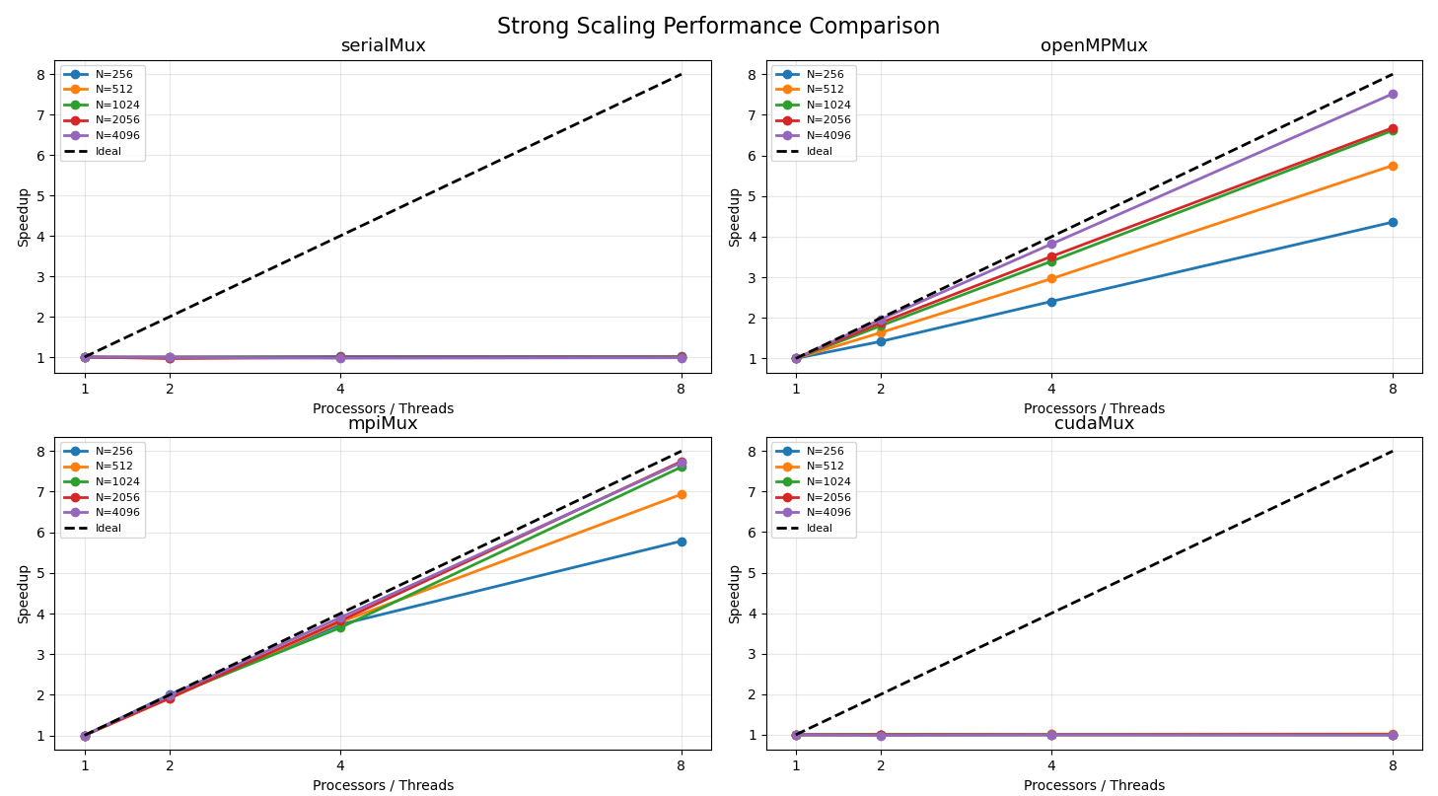
Speedup performance

Slide 11
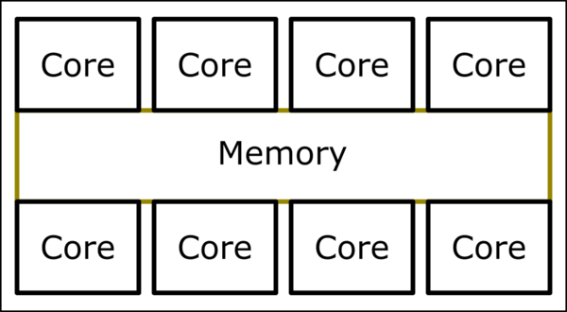
STRONG SCALING - openmp
When increasing threads from 1 → 16, runtime decreases almost proportionally.
At the end, we can achieve ~14.7× speedup and ~90% efficiency.
Slight drop due to memory bandwidth saturation
Interpretation:
Good scaling for shared memory
Cache-friendly loop order (IKJ) helps

Slide 12
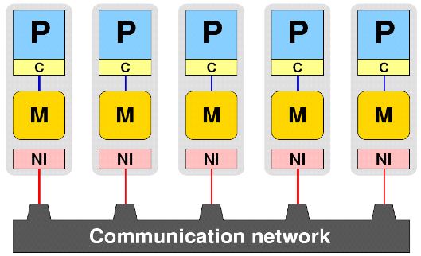
STRONG SCALING - mpi
MPI shows the best strong scaling of all CPU implementations.
Efficiency ≈ 95% (~15.4× speedup)
Very close to ideal
Interpretation:
Distributed memory avoids bandwidth bottlenecks
Communication overhead small for N = 4096
Binary: mpiMux
Size 1024: baseline T1 = 1.737085 s p=2: T=1.003811 s, speedup=1.730, eff=86.5% p=4: T=0.492298 s, speedup=3.529, eff=88.2% p=8: T=0.224643 s, speedup=7.733, eff=96.7%
Size 2056: baseline T1 = 16.496046 s p=2: T=8.301734 s, speedup=1.987, eff=99.4% p=4: T=3.572942 s, speedup=4.617, eff=115.4% p=8: T=2.023423 s, speedup=8.153, eff=101.9%
Size 4096: baseline T1 = 128.587012 s p=2: T=65.760728 s, speedup=1.955, eff=97.8% p=4: T=32.623750 s, speedup=3.942, eff=98.5% p=8: T=16.463687 s, speedup=7.810, eff=97.6%

Slide 13
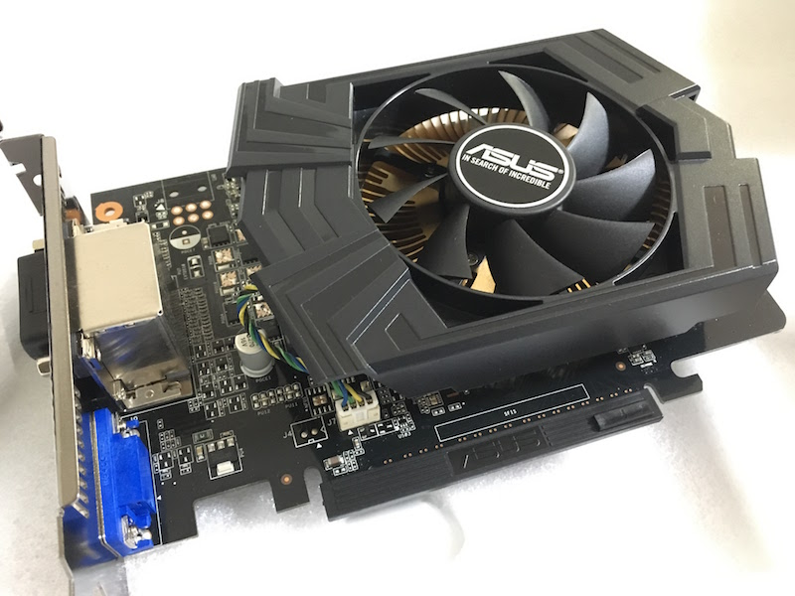
STRONG SCALING - CUDA
Strong scaling is not meaningful because the GPU is a fixed resource — you cannot “add processors” like with CPU threads.
Binary: cudaMux
Size 1024: baseline T1 = 0.006667 s p=2: T=0.000581 s, speedup=11.466, eff=573.3% p=4: T=0.000620 s, speedup=10.745, eff=268.6% p=8: T=0.000579 s, speedup=11.516, eff=143.9%
Size 2056: baseline T1 = 0.003641 s p=2: T=0.003633 s, speedup=1.002, eff=50.1% p=4: T=0.003629 s, speedup=1.003, eff=25.1% p=8: T=0.003637 s, speedup=1.001, eff=12.5%
Size 4096: baseline T1 = 0.026578 s p=2: T=0.026583 s, speedup=1.000, eff=50.0% p=4: T=0.026698 s, speedup=0.996, eff=24.9% p=8: T=0.026608 s, speedup=0.999, eff=12.5%
Size 6144: baseline T1 = 0.089160 s p=2: T=0.089307 s, speedup=0.998, eff=49.9% p=4: T=0.089263 s, speedup=0.999, eff=25.0% p=8: T=0.089195 s, speedup=1.000, eff=12.5%
CUDA runtime is extremely small (~0.00058s) and almost constant across sizes
Interpretations:
GPU is a fixed resource → cannot “add processors”
Kernel launch overhead dominates
GPU massively underutilized for these matrix sizes

Slide 14
Weak scaling
Definition: Increase problem size proportionally with processors
Ideal: Runtime stays constant
Notes:
Weak Scaling→ work per processor remains constant . For matrix multiplication: Work∝N³
If you double processors, matrix size should increase by:N∝P^{1/3}

Slide 15
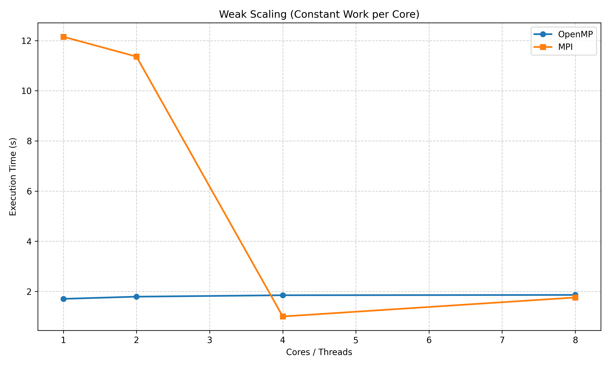
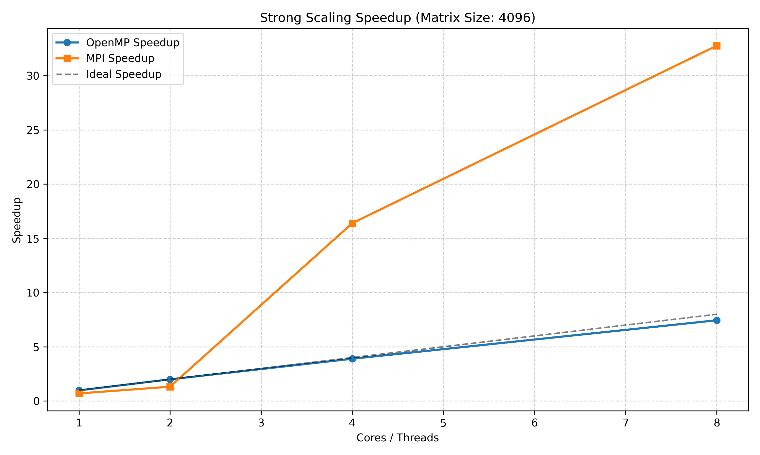
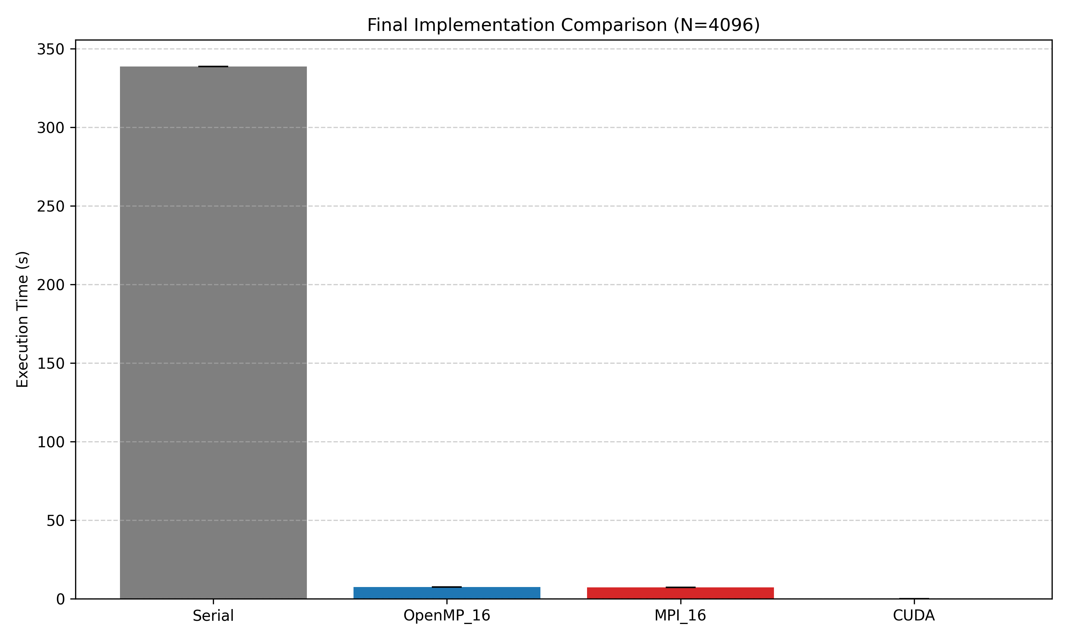
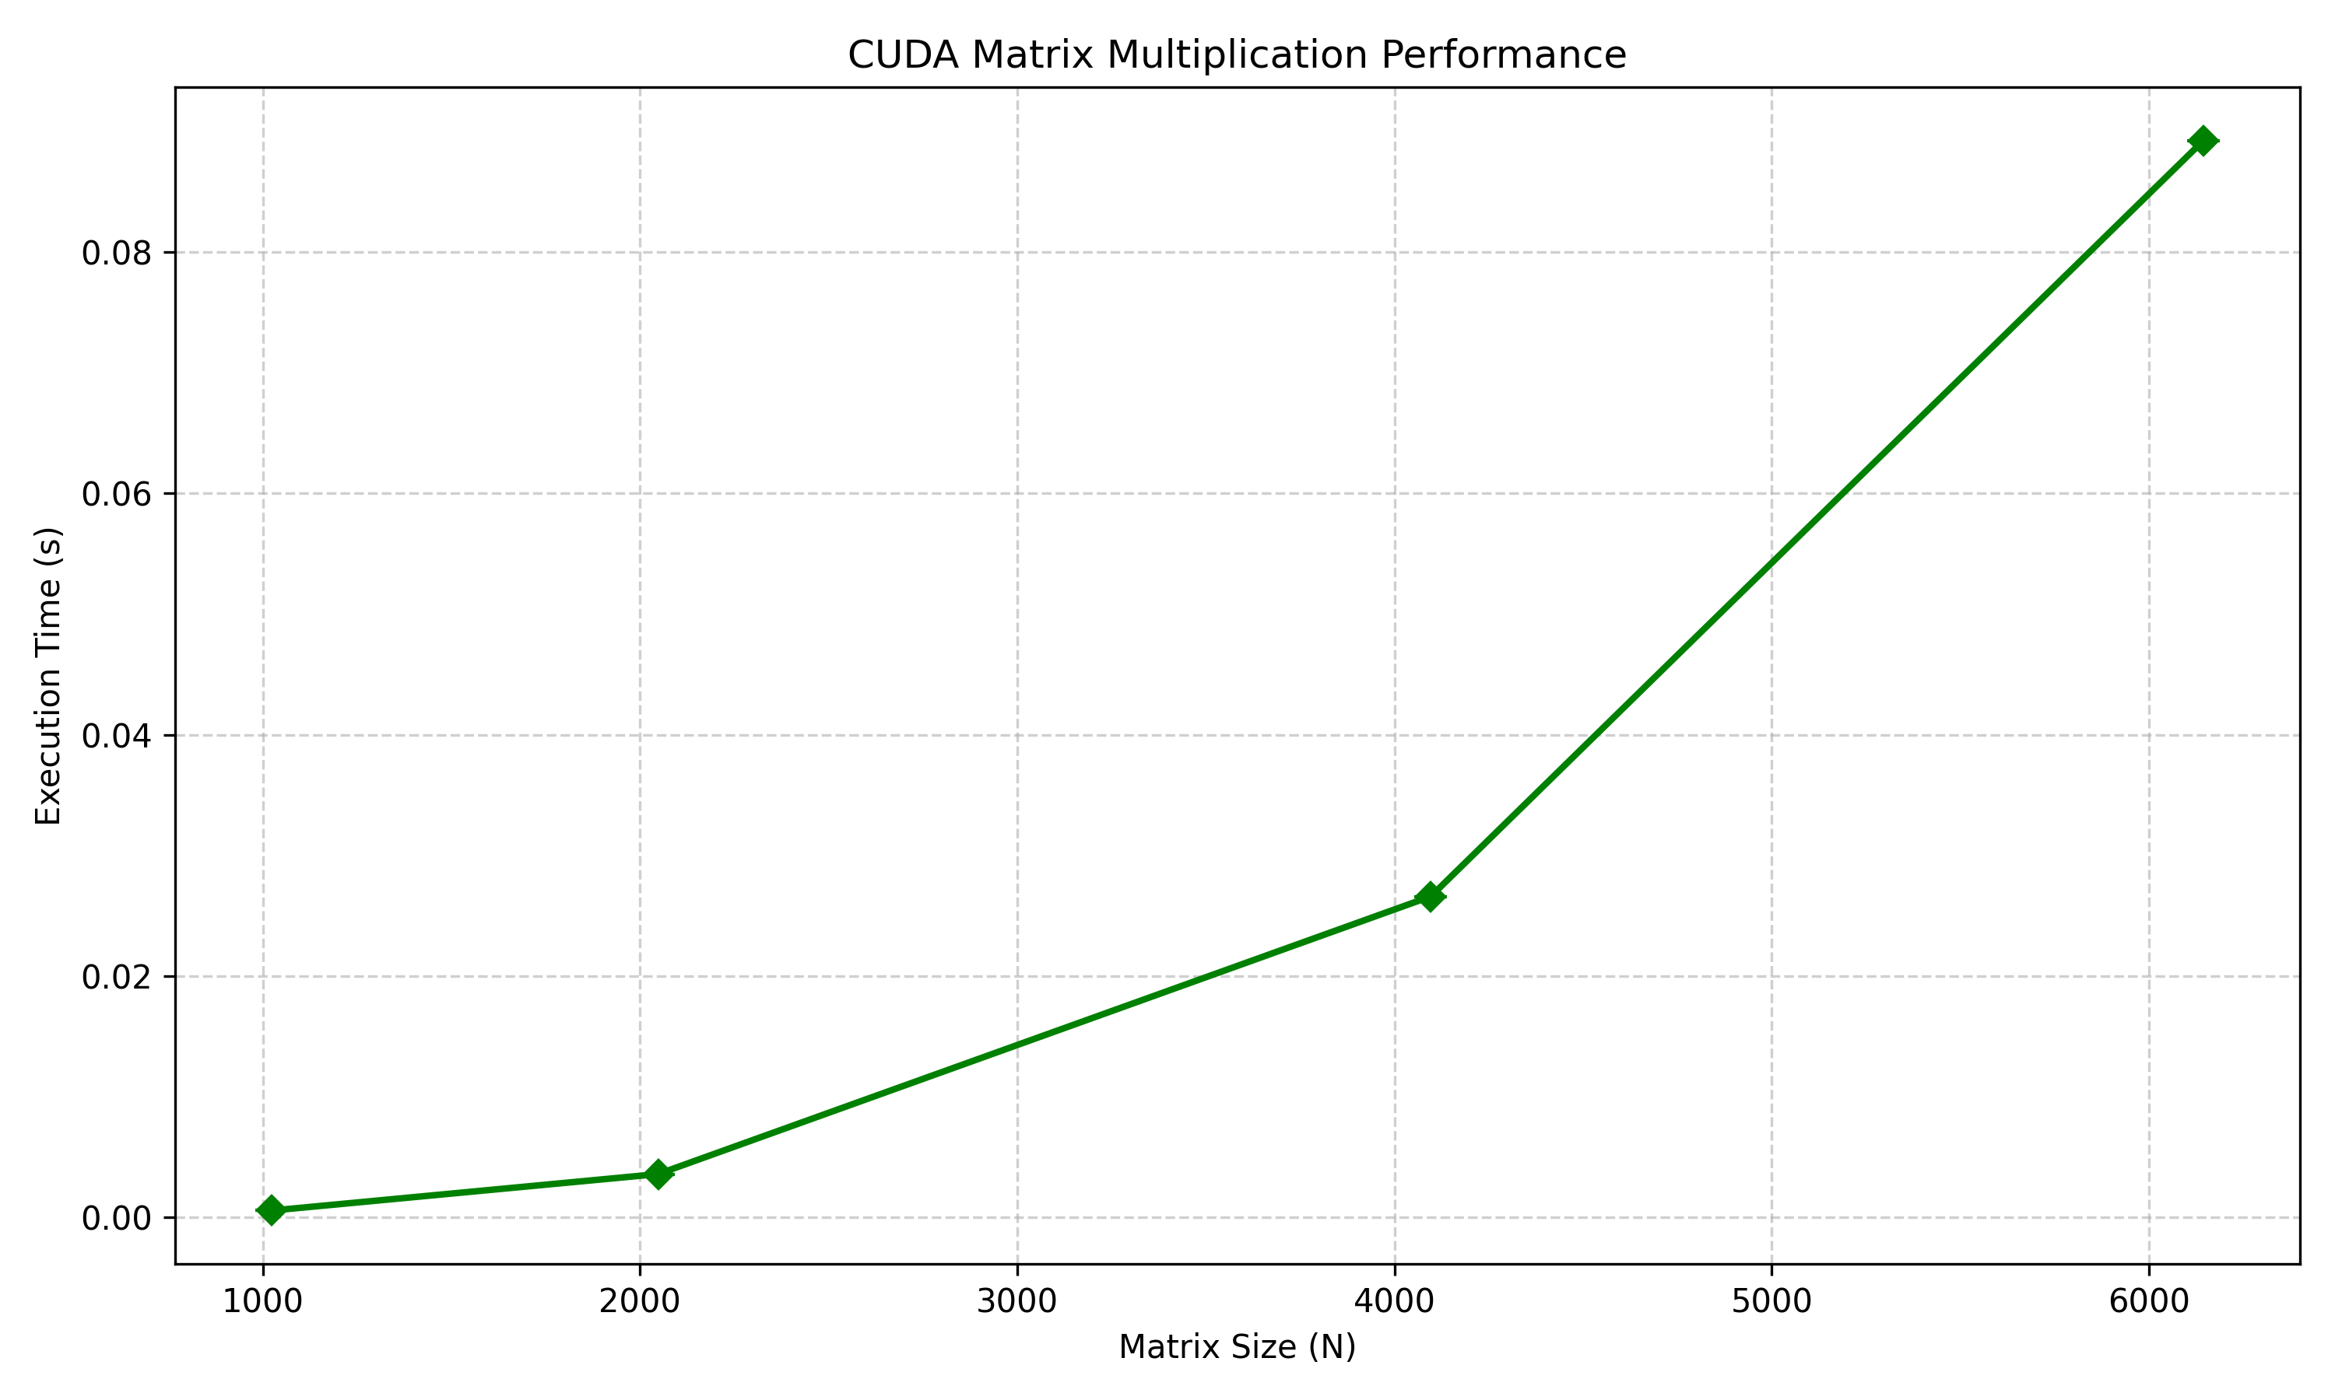

Slide 16
Speedup performance

Slide 17
weak SCALING - SERIAL
Baseline Reference
No use
binary, | procs, | Size, | T
serialMux | 1 | 1024 | 4.0842345 s
serialMux | 2 | 2056 | 30.0272 s
serialMux | 4 | 4096 | 379.2667 s
serialMux | 8 | 2048 | 39.3443 s

Slide 18
weak SCALING - openmp
Runtime increases a little
We notice an overhead
Interpretation:
Shared memory → bandwidth contention
Acceptable but not ideal
binary, | procs, | Size, | T
openMPMux | 1 | 1024 | 1.7010 s
openMPMux | 2 | 1290 | 1.7972 s
openMPMux | 4 | 1625 | 1.8667 s
openMPMux | 8 | 2048 | 1.9443 s
openMPMux | 16 | 2580 | 1.9136 s

Slide 19
weak SCALING - mpi
Runtime stays roughly constant
Interpretations:
Better than OpenMP
Distributed memory handles weak scaling well
Communication overhead grows slowly
binary, | procs, | Size, | T
mpi | 1 | 1024 | 1.6903 s
mpi | 2 | 1290 | 1.7578 s
mpi | 4 | 1625 | 1.0 s
mpi | 8 | 2048 | 1.78139 s
mpi | 16 | 2580 | 1.0 s

Slide 20
weak SCALING - CUDA
CUDA times constant across sizes
Interpretation:
Weak scaling not meaningful
Kernel overhead dominates
GPU not stressed enough
binary, | Size, | T
Cuda | 1024 | 0.000581 s
cuda | 2048 | 0. 000576 s
cuda | 4096 | 0. 000593 s
cuda | 6144 | 0. 000607 s
Notes:
Strong-Scaling for Cuda means : instead of a fixed N we have a fixed launch configuration :
We have to vary N => 1024,2048,4096,6144
Weak-Scaling

Slide 21
SUMMARY
Overall, MPI provides the best strong and weak scaling because distributed memory avoids bandwidth bottlenecks.
OpenMP also scales well, especially in strong scaling, but is limited by shared memory.
CUDA is by far the fastest implementation in absolute runtime, but scaling metrics are not meaningful because the GPU is a fixed resource.
The serial implementation serves as a correctness and performance baseline

Slide 22

Thank You

